Slide 1
S-NPP Sounder Information
Bradley Zavodsky
NASA/MSFC

Slide 2
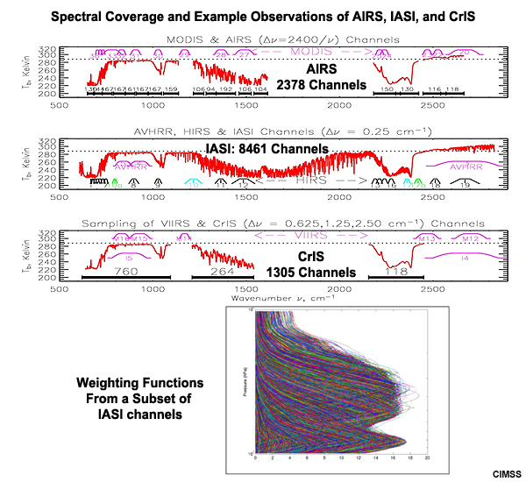
S-NPP Sounder Specifications
Image credit: CIMSS
 | AIRS (2002-present) | IASI (2006-present) | CrIS (2011-present)
Owner | NASA | EUMETSAT | NASA/NOAA
Satellite | Aqua | Metop A/B | Suomi-NPP/JPSS (future)
Instrument Type | Grating spectrometer | Fourier transform spectrometer | Fourier transform spectrometer
Number of channels | 2378 | 8464 | 1305
Wavelength range | 3.7-15.4 μm | 3.6-15.5 μm | 3.9-15.4 μm
Spectral sampling | ν/Δν = 1200 | 0.5 cm⁻¹ | 0.625 cm⁻¹
FOV Size (at nadir) | 13.5 km | 12 km | 14 km
Swath Width | 1650 km | 1100 km | 2200 km
Equator Crossing Local Time | 1330 (ascending) | 0930 (descending) | 1330 (descending)

Slide 3
S-NPP Sounder Products
CrIS is coupled with ATMS in a similar way that AIRS is coupled to AMSU to produce retrieved profiles of temperature, moisture, and trace gases
Coupling with microwave sensor allows for retrievals in partly cloudy Fields of Regard (3x3 array of CrIS FOVs) to increase the number of available observations
CDRs providing continuity of NASA atmospheric temperature, moisture, and trace gas measurement (AIRS → CrIS) will be available through the Sounder SIPS which is a partnership of JPL and GES DISC (PI: Steve Friedman, JPL)
From: Bingham et al. (2010)
L2 Products
Temperature soundings
Moisture soundings
Aerosols
Radiation budget
Ozone

